Slide 1
Mood detection in tweets
By Thomas Emment
Notes:
Why am I doing this

Slide 2


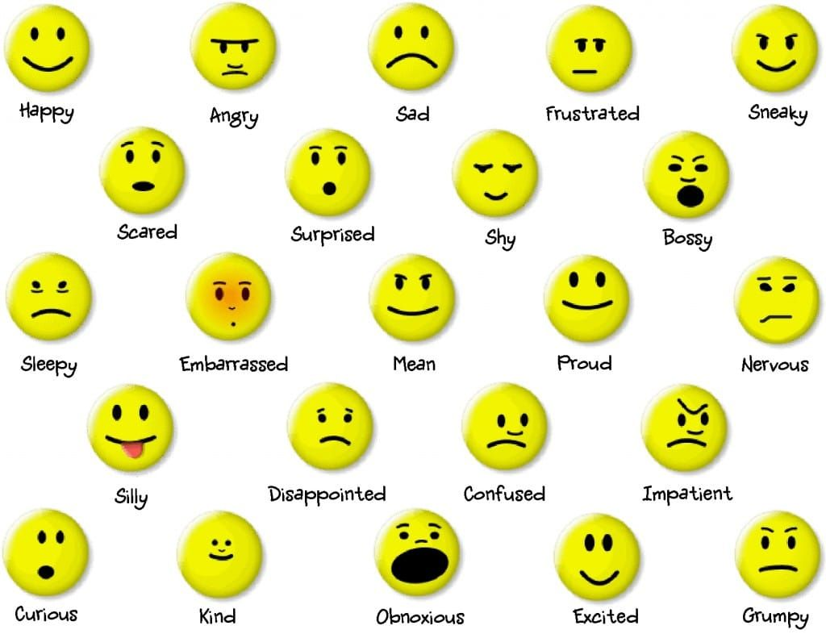

Emotion Classification
Notes:
Human wide range of emotion, Opposites, reasons for doing this and how it helps, done in an achievable time

Slide 3

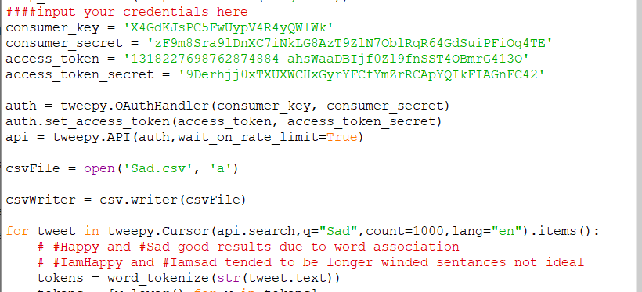

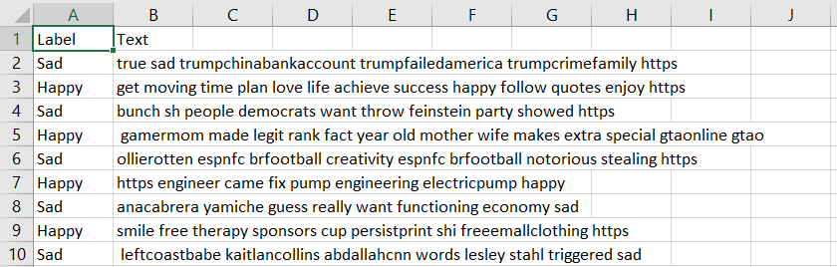
Dataset creation
Search term
Notes:
how tweepy works, Search terms, amount of terms (16k), not pretty tweets

Slide 4

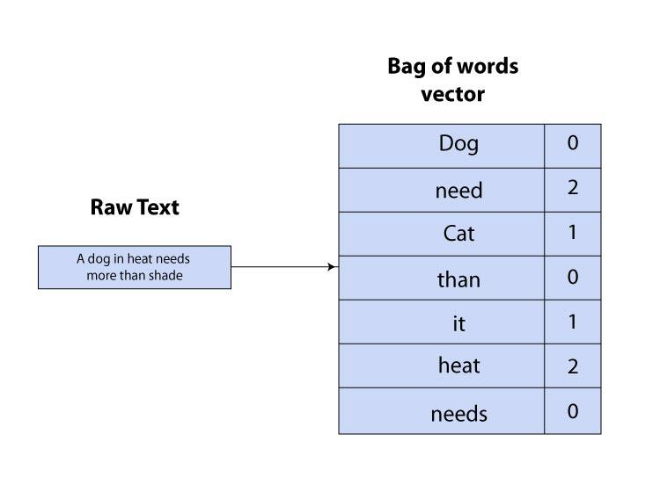
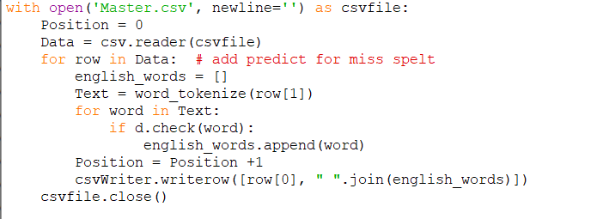
Data Preprocessing
Concerns:
Duplicates
Links and emojis
Spelling errors
Vectorization
Check if word
Notes:
Why and how, Enchant, Explain vectorization, talk about splitting data

Slide 5
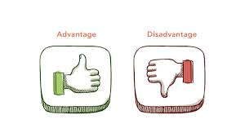
Model selection
My main options where: Logistic Regression, Decision Trees and Support Vector Machines
I chose a Support Vector Machine for the following reasons:
The long training time of a Support Vector Machine is not a concern
Allows classification as well a misclassification – which will be key for dealing with text
Works well with a high number of features which I will have
Generalizes much better than decision trees

Slide 6
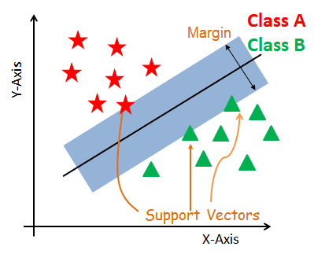
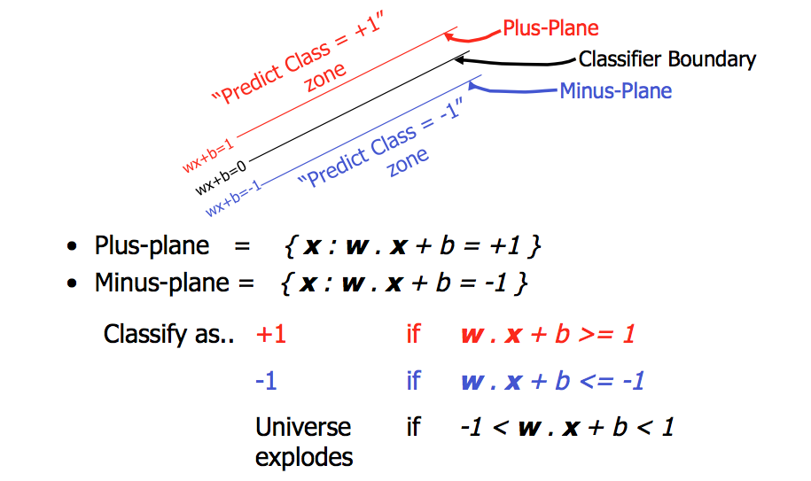
What is a support vector machine
Aims too split data along a decision boundary (hyper plane). Data points that fall one side with be classified as x while on the other side y
The Decision boundary has support vectors, this is a margin of the closest point on each side of the decision boundary, the algorithm aims to make the margin as wide as possible
Distance from points to the plane are calculated using the dot product, the hyper plane aims to maximize the distance from points while support vectors minimize to the closest points from the decision boundary
(2)
(2)

Slide 7
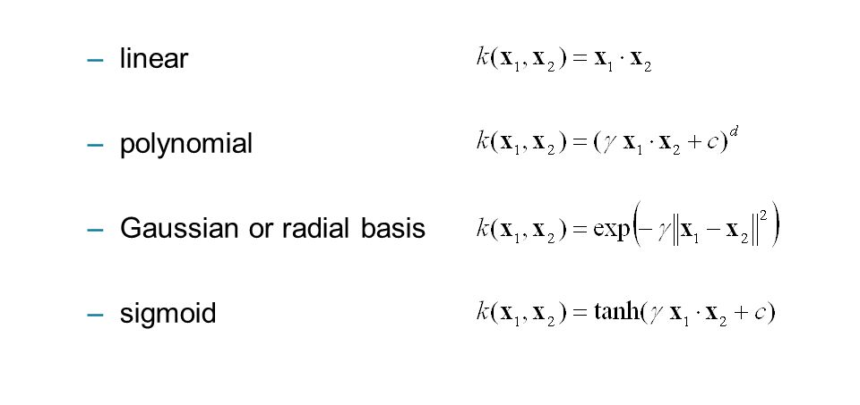
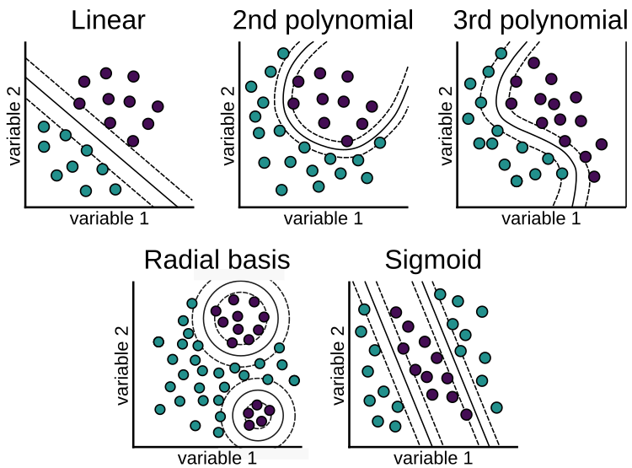
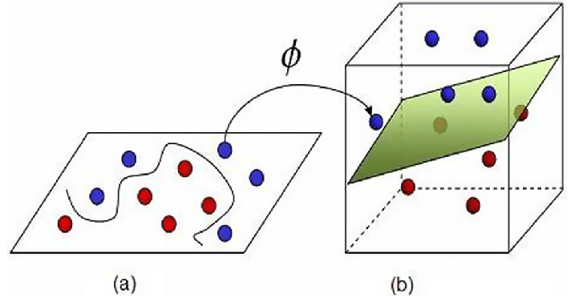
Features of a support vector machine
Margins can be changed to allow higher amounts of misclassified data between them
The Kernel choice transforms data into different spaces for separating data with non linearly separable patterns
(4)
(3)

Slide 8
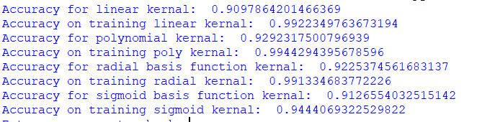
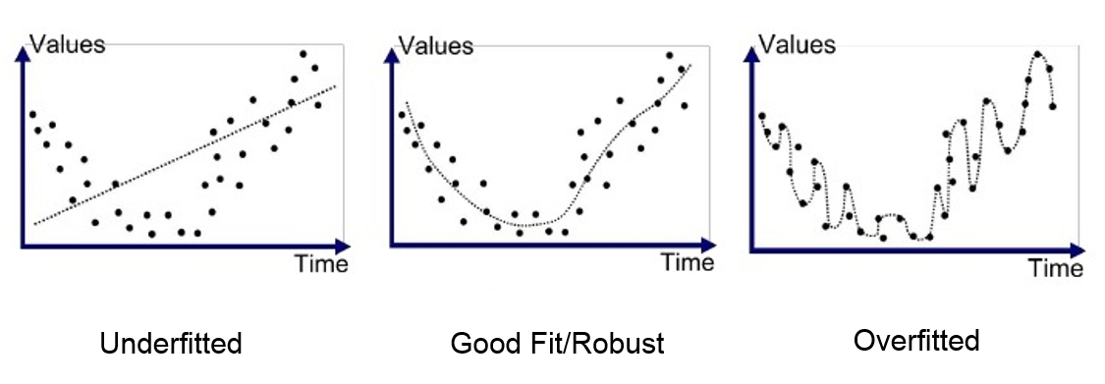
Initial results
Amazing accuracy but clearly overfitting is occurring
Kernel | Accuracy (Test data) | Accuracy (Training data)
Linear | 91% | 99%
Polynomial | 93% | 99%
Radial | 92% | 99%
Sigmoid | 91% | 94%

Slide 9
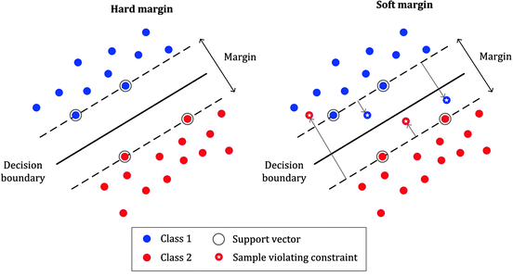
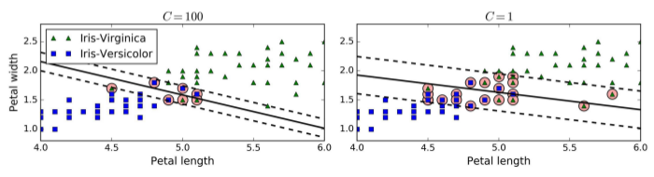
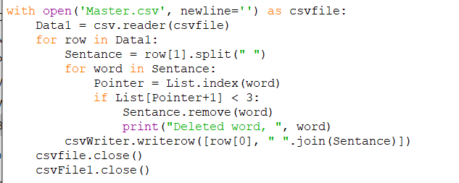
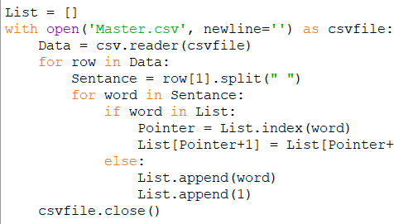
Addressing overfitting
Reduce C value to allow more misclassification and better generalization
Reduce number of variables
(1)
(1)

Slide 10
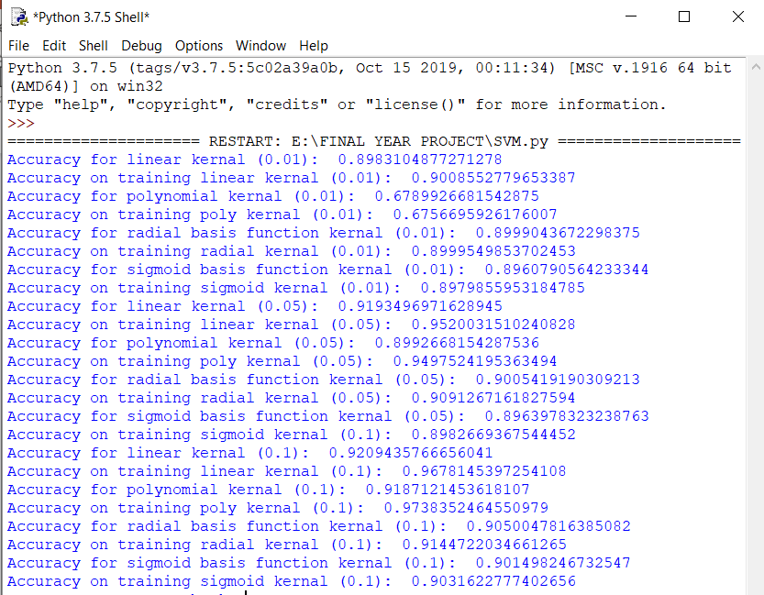
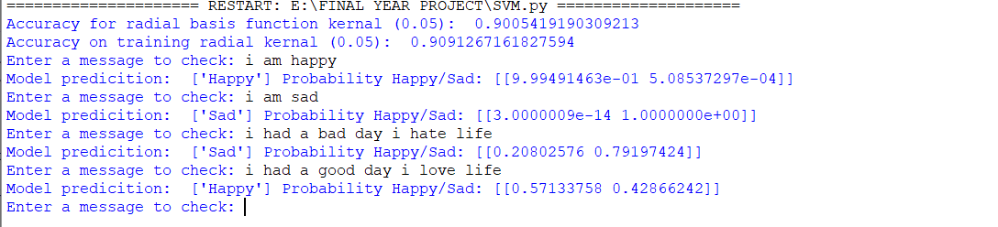
Evaluating the results
Top model (without suffering from overfitting):
Model | Accuracy (training) | Accuracy (test)
Radial (0.05) | 91% | 90%
Testing the model on some easy to classify messages (for a human), it does pretty well!

Slide 11

Future plans
Classify a broader range of emotions making my model more complex but smarter
Deal with the loss of data due to misspellings and compare this model to previous versions
Introduce a cross validation set for further model tuning
Try some new machine learning techniques such as 1d convolutional neural networks and Adaboost

Slide 12

Thank you for listening
REFRENCES:
(1)Hands on machine Learning with sklearn by Aurelian Geron (Chapter 5)
(2)Machine learning by Andrew NG (Lecture 12)
(3) https://www.analyticsvidhya.com/blog/2020/10/the-mathematics-behind-svm/
(4) https://www.r-bloggers.com/2019/10/support-vector-machines-with-the-mlr-package/
Any questions?

